Slide 1



For Windows
Iordanis Kostelidis, Software Engineer

Slide 2
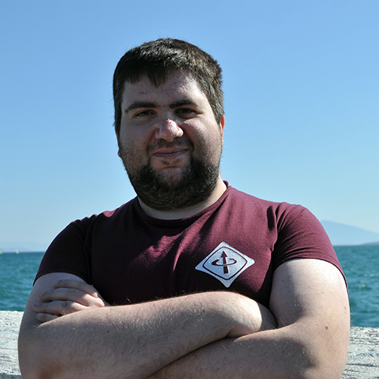
Meet the speaker
Iordanis Kostelidis
Final Year Student @ IHU
Student Member @ IEEE
IEEE Computer Society
IEEE Robotics and Automation Society
….
Chair @ IEEE IHU Serres
Software Engineer* @ DataScouting

Slide 3
Topics
(or what we will see today)
What is IEEE and IEEE Computer Society?
What is Virtualization?
What is Docker?
Why Docker?
Basic Docker Commands
Docker in Practice

Slide 4
What is IEEE?
Professional association
Engineers (Software, Hardware, Electrical, Communication etc)
320.000+ Members
1,300+ Members is Greece
3.400+ Student Branches
75,000+ Students
500+ Students in Greece
Known for:
LAN/MAN Network Standard Family (IEEE 802)
WiFi Network Standard Family (IEEE 802.11)

Slide 5
What is IEEE Computer Society?
Professional association
Informatics, Computer and Software Engineers
43.000+ Members
230+ Members is Greece
50+ Students in Greece
Committees
Intelligent Informatics
Security and Privacy
Software Engineering
Co-Creator of “Software Engineering Code of Ethics and Professional Practice”
ACM / IEEE CS

Slide 6
What is Virtualization?
Virtualization refers to the act of creating a virtual (rather than actual) version of something, including virtual computer hardware platforms, storage devices, and computer network resources.

Slide 7
What is Docker?
Platform as a service (PaaS)
OS-level virtualization
Isolated containers
Single OS kernel
Very Fast

Slide 8
Why Docker?
Dev/Production has the same environment
For example: Same OS version, Same PHP version
Easy Deployment
One-command deployment
Safe Environment Updates
For example: PHP 7.1 -> 7.4
VCS has the Environment Configuration

Slide 9
Basic Docker Commands
docker pull [image-name]:[version]
Example:
docker pull phpmyadmin/phpmyadmin:5
docker run [args] [image-name]
Example:
docker run -d --name phpma -p 80:80 phpmyadmin/phpmyadmin:5
docker ps
docker stats

Slide 10
Basic Docker Commands
docker exec [args] [container-name] [command]
Example:
docker exec -it phpmyadmin-docker bash
docker stop [container-name]
Example:
docker stop phpmyadmin-docker
docker rm [container-name]
Example:
docker rm phpmyadmin-docker

Slide 11
Basic Docker Commands
docker build [args] [path]
Example:
docker build -t myimage:alpha .

Slide 12
Docker in Practice

Slide 13


